Slide 1
Text Recognition and Dynamically Loading Related Images in Augmented Reality
Abhishek Jaiswal (IIT2013129)
Supervised By:
Dr. Shirshu Varma

Slide 2
PROBLEM DEFINITION
To build an interactive, and dynamic software which -
recognizes printed English words, crawls web in real time downloading meaning of the word and reference images.
Positions the crawled content relative to text recognized in augmented reality.

Slide 3
OBJECTIVES
We intend to make an efficient software :
To be accurate enough to recognise as many words of English text.
Should be lightweight so it can be operated on mobile devices.
To be dynamic so as to crawl the web and download the meaning and image specific to any given English word.
To use power of augmented reality to make understanding of words more useful by attaching virtual objects(meaning, models/ images) with the trackable text in the region of interest.

Slide 4
INTRODUCTION
While reading whenever we come across words whose meaning is unclear to us, each time we have to refer to a paper dictionary or open a dictionary app, type the word and what we get is only the meaning of the word in written form.
We present a more realistic form of visual dictionary that let's you visualize and feel the meaning and model or illustration of the word without the effort of searching or typing, just by hovering over your camera over the printed word.
Also the illustrations are displayed in the real world alongside the queried word using augmented reality so that you can also feel and visualize them.

Slide 5
MOTIVATION
Augmented reality has many applications in a variety of fields – IoT, military, industrial, and medical, commercial and entertainment areas, sign boards, video games, industrial design , sports,education.
We felt the need of having a software that can help us have a more realistic meaning of a word in the text we come across in our day-to-day lives without searching them manually in a dictionary.
Our idea can be developed and used for educational purposes as well as by language translators.

Slide 6
METHODOLOGY
Our project consists of three main phases :
Text Recognition
(Identifying words in
ROI by a Bounding Box)
Real Time Web Crawling for meaning and images related to the word
Dynamic Positioning of crawled contents relative to the word in Augmented Reality

Slide 7
Text Recognition
In our project, text recognition includes detecting and tracking of printed English words within a defined detection window referred to as a region of interest (ROI).
The words are then matched against a defined list of words. We are using the base set of words in the Vuforia word -list as a reference for matching text elements that appear in the ROI in camera field-of-view.
Word lists are loaded from a binary file encoded in the Vuforia Word List (VWL) format. A default VWL file contains over 100,000 high-frequency English words and is distributed in a bundle with the Vuforia SDK. The default word list can be extended with additional word lists and the word list can be filtered.
The Vuforia text recognition engine words and wordlists utilize the UTF-8 character encoding standard and recognise the following characters - space, ‘ , -, A to Z, a to z.

Slide 8
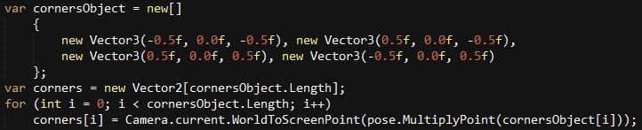
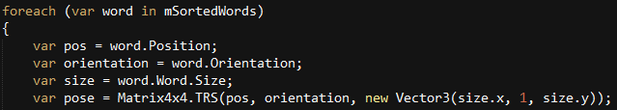
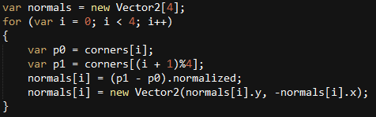
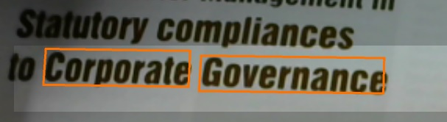
Dynamically creating Bounding Box around Recognised words
load the position, orientation,
scale of detected word.
Find coordinates of different corners.
Upper Left (-0.5f, 0.0f, -0.5f)
Upper Right (0.5f, 0.0f, -0.5f)
Down Left (-0.5f, 0.0f, 0.5f)
Down Right (-0.5f, 0.0f, 0.5f)
Take adjacent corners at a time and draw normal line.
X
canvas
Y
Z

Slide 9
Dynamically Loading Meaning and Images
Take first word from list of detected word
if either image or meaning not loaded
Load image Load Meaning Image
Add scale (10f, 10f, 10f) Add scale (25f, 8f, 5f)
Rotate by 180 around Y.
pos.z -= imageSize; pos.x += imageSize;
clone.transform.position = pos; cllone.transform.position = pos;
Destroy(cubeClone, 0.1f);
false
true
@"\bhttp://t0\.gstatic\.com\S*"
per frame compilation
if mutex free & image not loaded
true
mutex
Google Image Crawling
link of image
Download link subroutine
false
if mutex free & meaning not loaded
true
Crawl thefreedictionary.com for meaning
cloud link of gen image
set google image downloaded,
free ->mutex
set meaning image downloaded,
free ->mutex
Call Text to image API
@"\bclass=\Scustom_entry\S>(.*?)</div>"

Slide 10
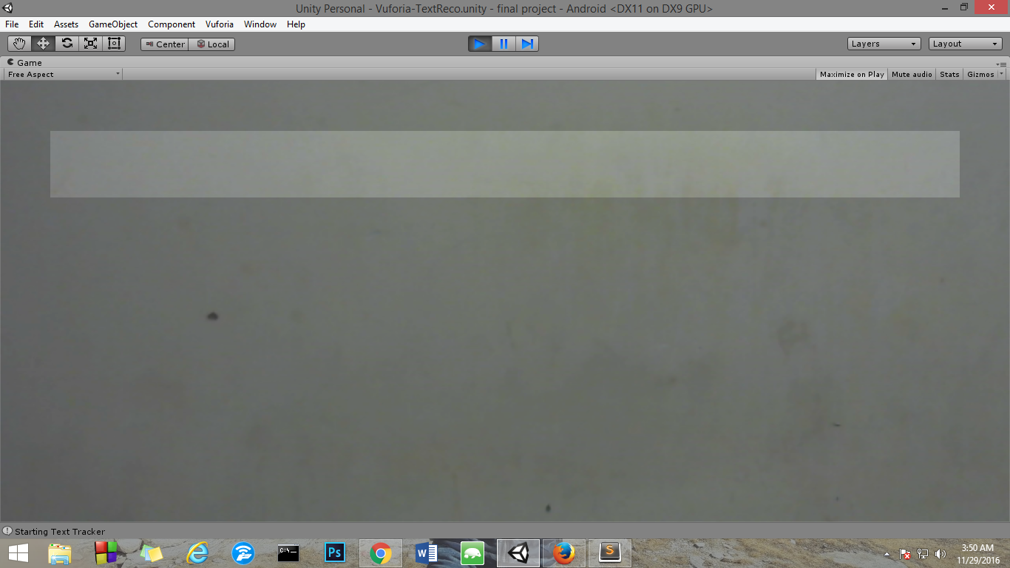
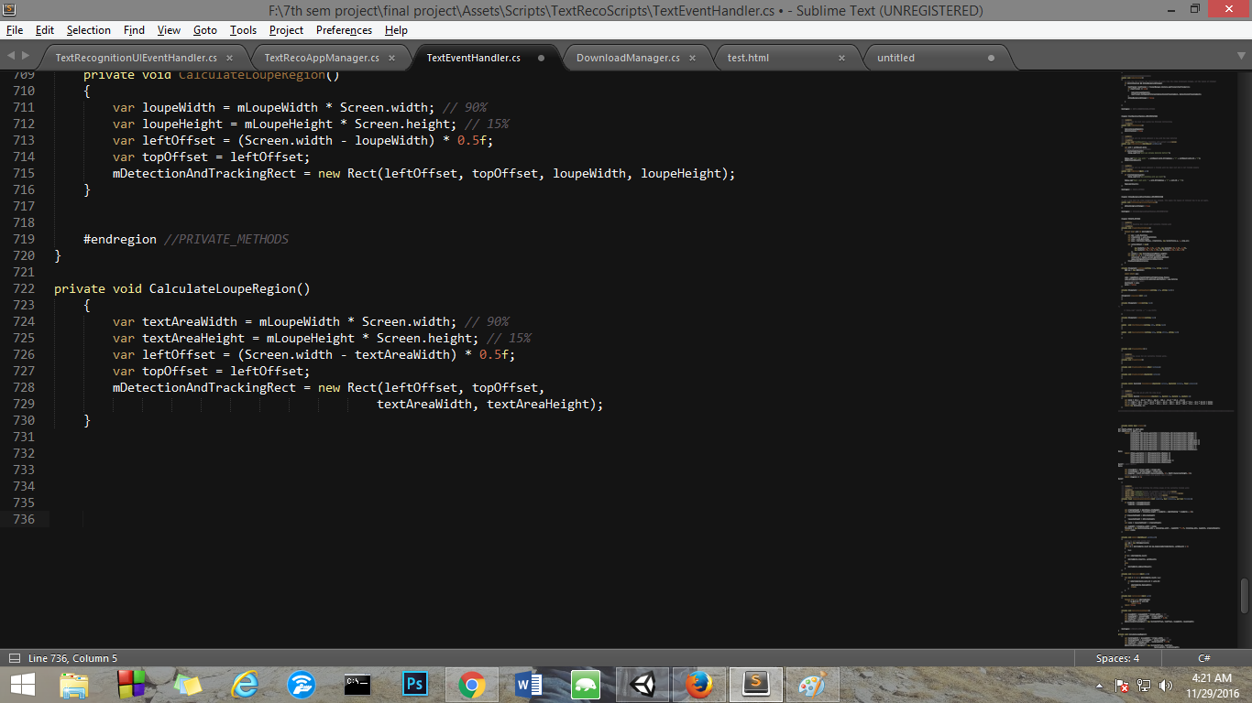
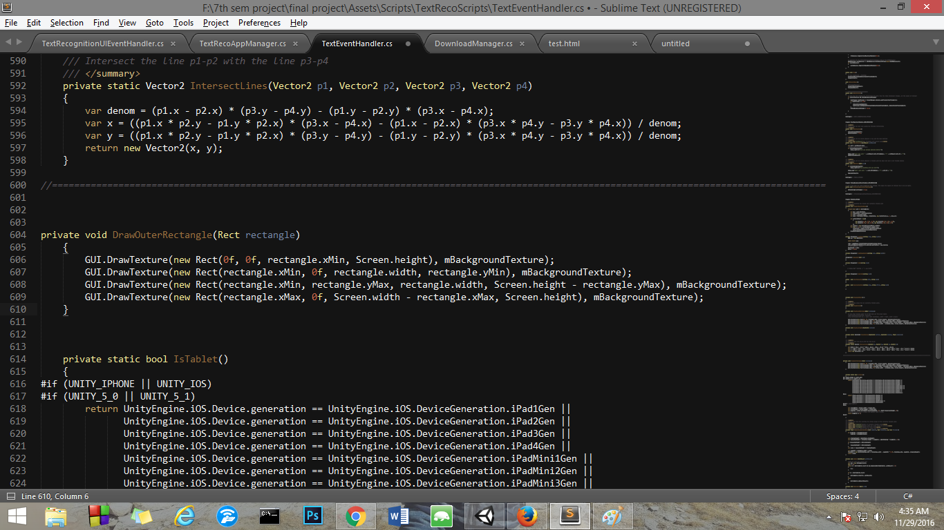
Canvas GUI Design
A
D
B
Text Recognition Region
RECTANGLE C

Slide 11
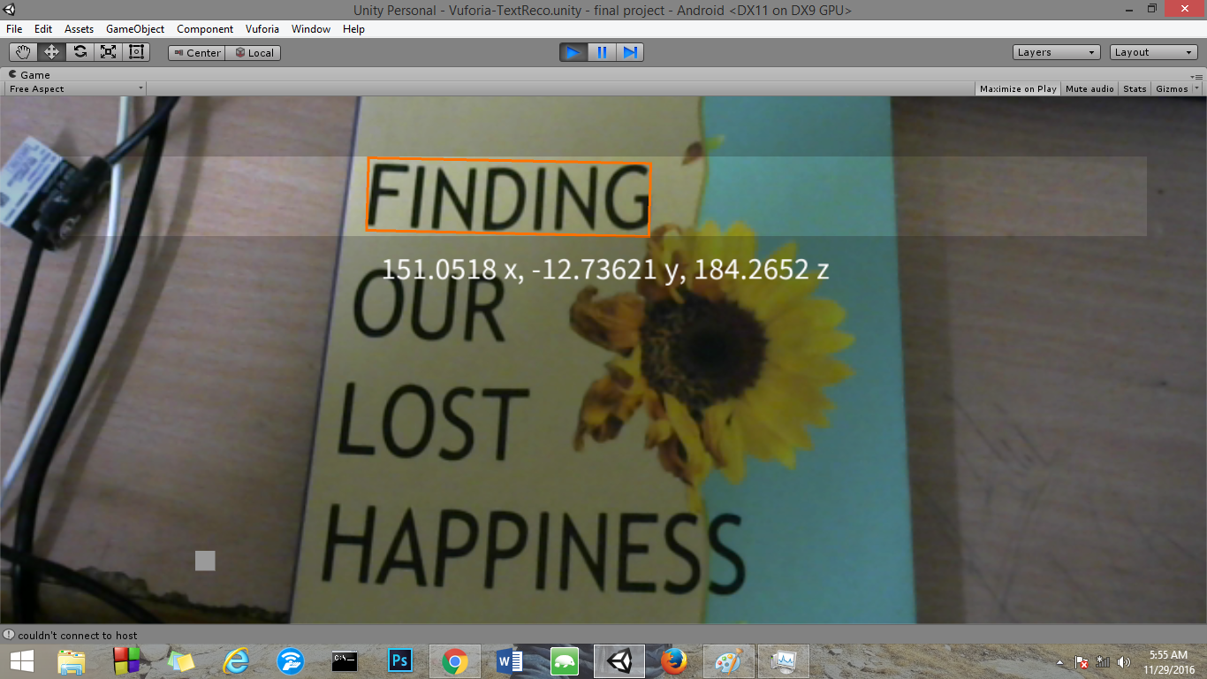
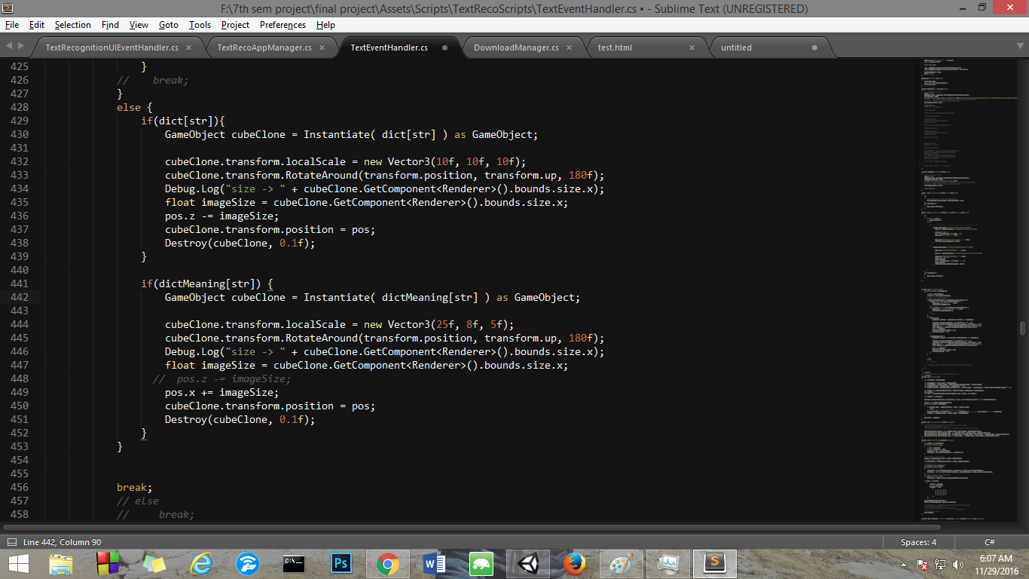
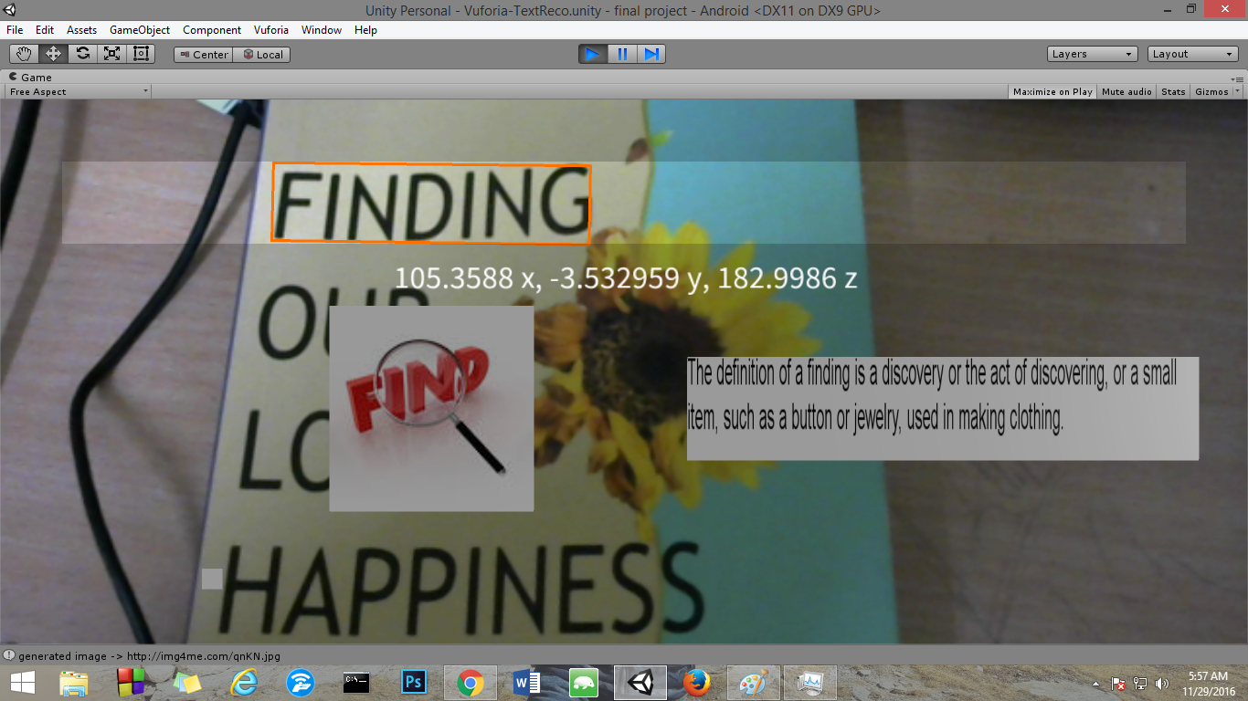
Dynamically Placing Images in Augmented Reality

Slide 12
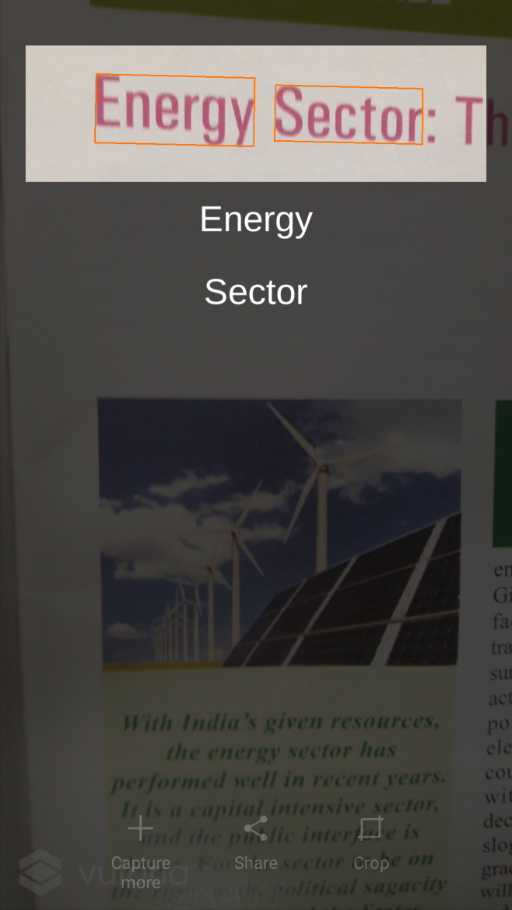
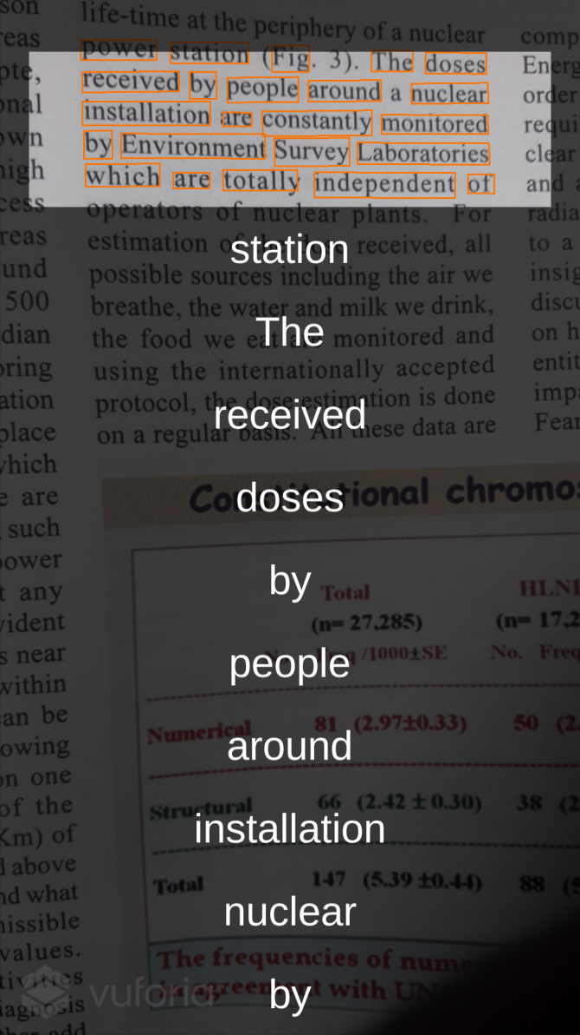
Snapshots of Work Done
(Pre-Mid Sem)

Slide 13
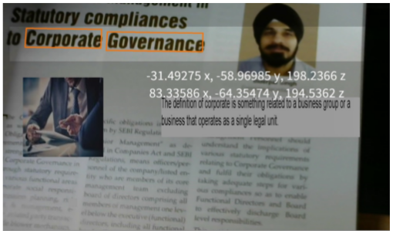
Snapshots of Work Done
(Post Mid-Sem)
Co-ordinates of the detected word
Bounding Box for “corporate”
Meaning of the detected word
Image attached to word

Slide 14
Challenges Faced
3D models are not available for free on the internet.
API for Images and meaning of the word are not available.
Downloading of the contents has to be done sequentially and through a mutex lock so that different words don’t start the download consequently.
Downloading of content has to be done in a separate subroutine independent of per frame sequential execution otherwise frames freeze.

Slide 15
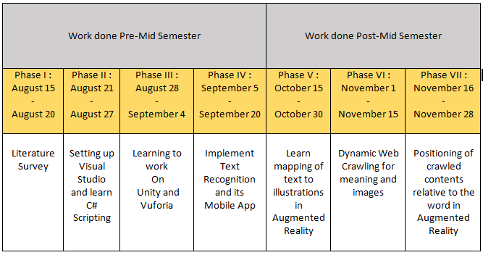
Activity Time-Chart

Slide 16
Hardware and Software Requirements
Software/Tools :
C# Scripting
Unity 3D
Microsoft Visual Studio 2013 or later
Vuforia
Sublime Text
Other Requirements:
Web Camera
OS: Windows 7 SP1+, 8, 10; Mac OS X 10.8+,Android
GPU: Graphics card with DX9 or DX11 with feature level 9.3 capabilities

Slide 17
Future Scope
By extending our project to use 3D Models and/or Videos it will open another dimension in how we understand our day to day words we come across.
We can build a central database on cloud storing images, videos, 3d model, meaning related to word which will further make rendering of object in augmented reality real fast.
Support for different languages apart from english will enable people across world to use the app.

Slide 18
Conclusion
We successfully implemented real time text recognition for about one million English words in the Vuforia word list.
We further extended our algorithm for dynamic web crawling of meaning(from thefreedictionary.com) and image(from Google Images) of the detected words in the region of interest.
We next positioned the crawled content relative to the detected word at runtime in augmented reality.

Slide 19
REFERENCES :
[1] Hideaki Uchiyama, Eric Marchand;” Object Detection and Pose Tracking for Augmented Reality:Recent Approaches”
[2] Youngo Lee, Jongmyong Choyee, ”Tideland Animal AR:Superimposing 3D Animal Models to user defined targets for Augmented Reality Game”
[3] Marc Petter, Victor Fragoso, Matthew Turk, Charles Baur, “Automatic text detection for mobile augmented reality translation”
[4]https://unity3d.com/learn/tutorials/topics/scripting/coding-unity-absolute-beginner
[5] https://library.vuforia.com/tutorials
[6] http://www.thefreedictionary.com
[7] https://docs.unity3d.com/Manual/UnityManual.html
[8]https://library.vuforia.com/articles/Solution/How-To-Implement-Text-Recognition-in-Unity

Slide 20
THANK YOU

